Slide 1
CS 316: Introduction to Deep Learning
Linear Regression
Week 5
Dr Abdul Samad

Slide 2
Lecture Outline
Linear Regression Model
Single Layer Neural Network
Evaluating Linear Regression Model
Training Linear Regression Model
Optimization
Gradient Descent
Learning Rate
Mini Batch Stochastic Gradient Descent

Slide 3
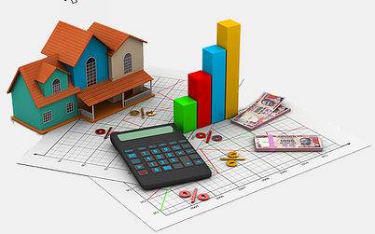
House Price Prediction
Predict price of the house based on its features.
The features in consideration are:
Total Area
Number of Bedrooms
Number of Bathrooms
Figure taken from medium

Slide 4
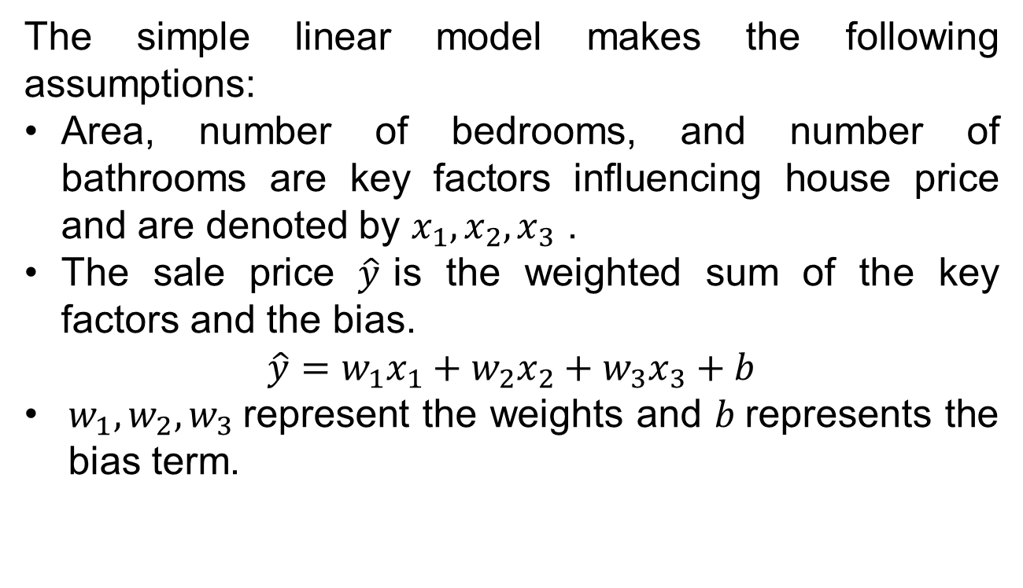
House Price Prediction
The simple linear model makes the following assumptions:
Area, number of bedrooms, and number of bathrooms are key factors influencing house price and are denoted by $x_{1}, x_{2}, x_{3}$ .
The sale price $\hat{y}$is the weighted sum of the key factors and the bias.
$$\hat{y}=w_{1}x_{1}+w_{2}x_{2}+w_{3}x_{3}+b$$
$w_{1},w_{2},w_{3}$represent the weights and $b$represents the bias term.

Slide 5
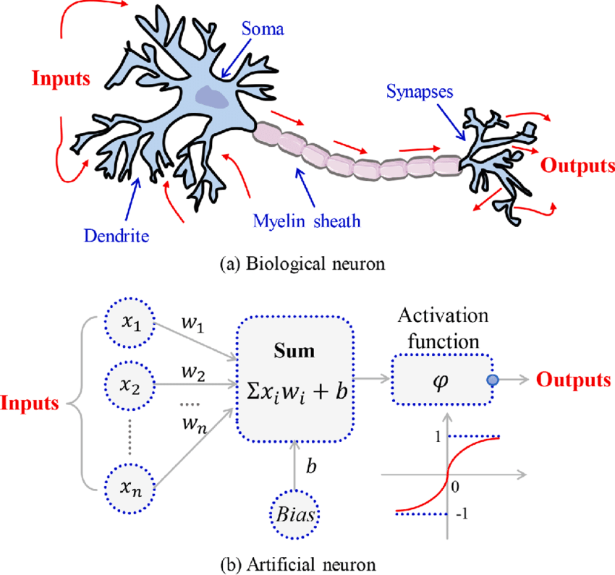
Biological Neuron vs Artificial Neuron
Figure taken from ResearchGate

Slide 6
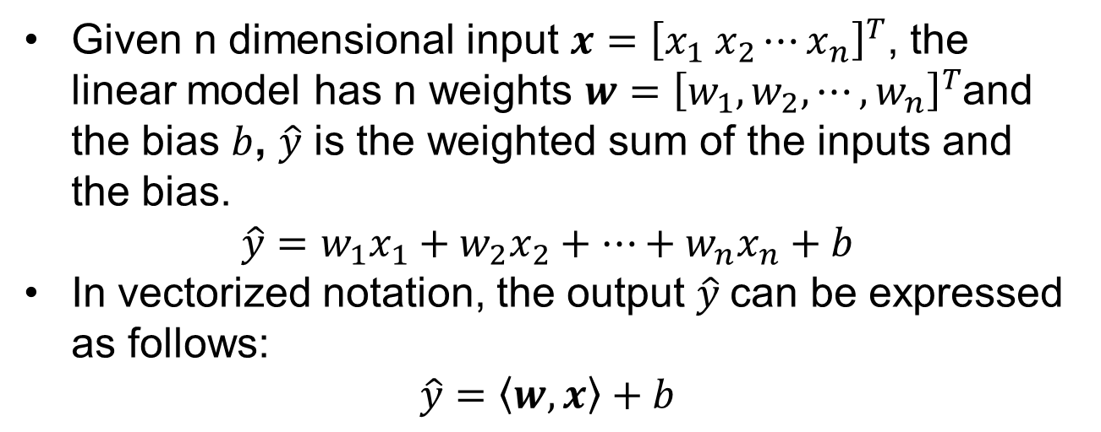
Linear Model
Given n dimensional input $x={\left[x_{1} x_{2}⋯x_{n}\right]}^{T}$, the linear model has n weights $w={\left[w_{1}, w_{2}, ⋯,w_{n}\right]}^{T}$and the bias $b$, $\hat{y}$ is the weighted sum of the inputs and the bias.
$$\hat{y}=w_{1}x_{1}+w_{2}x_{2}+⋯+w_{n}x_{n}+b$$
In vectorized notation, the output $\hat{y}$can be expressed as follows:
$$\hat{y}=\left\langle w, x\right\rangle +b$$

Slide 7
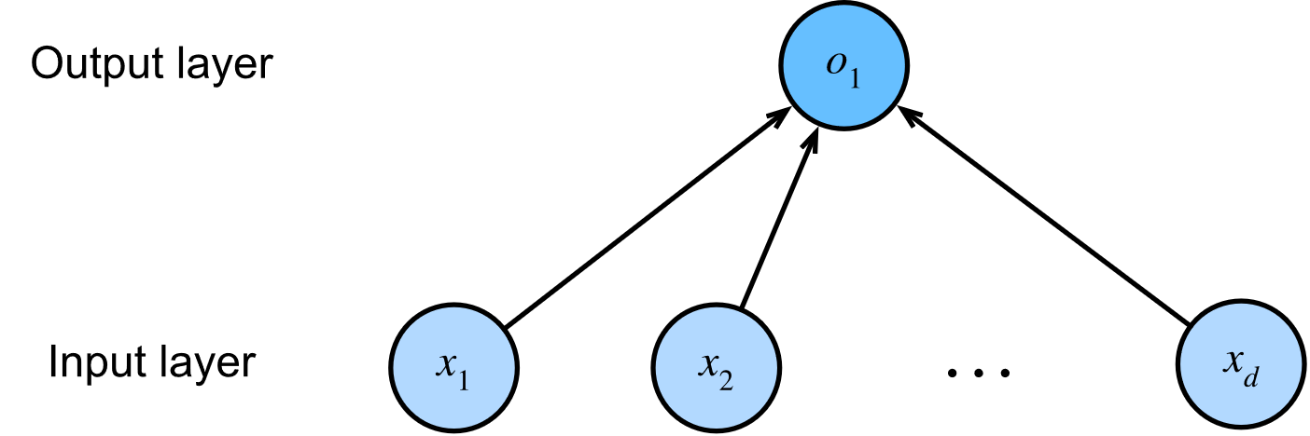
Single Layer Neural Network
Figure taken from d2l.ai

Slide 8
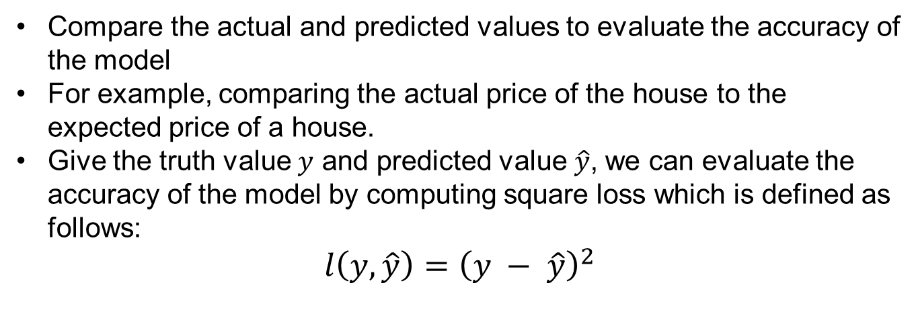
Evaluating Accuracy of the Model
Compare the actual and predicted values to evaluate the accuracy of the model
For example, comparing the actual price of the house to the expected price of a house.
Give the truth value $y$ and predicted value $\hat{y}$, we can evaluate the accuracy of the model by computing square loss which is defined as follows:
$l\left(y,\hat{y}\right)={\left(y − \hat{y}\right)}^{2}$

Slide 9
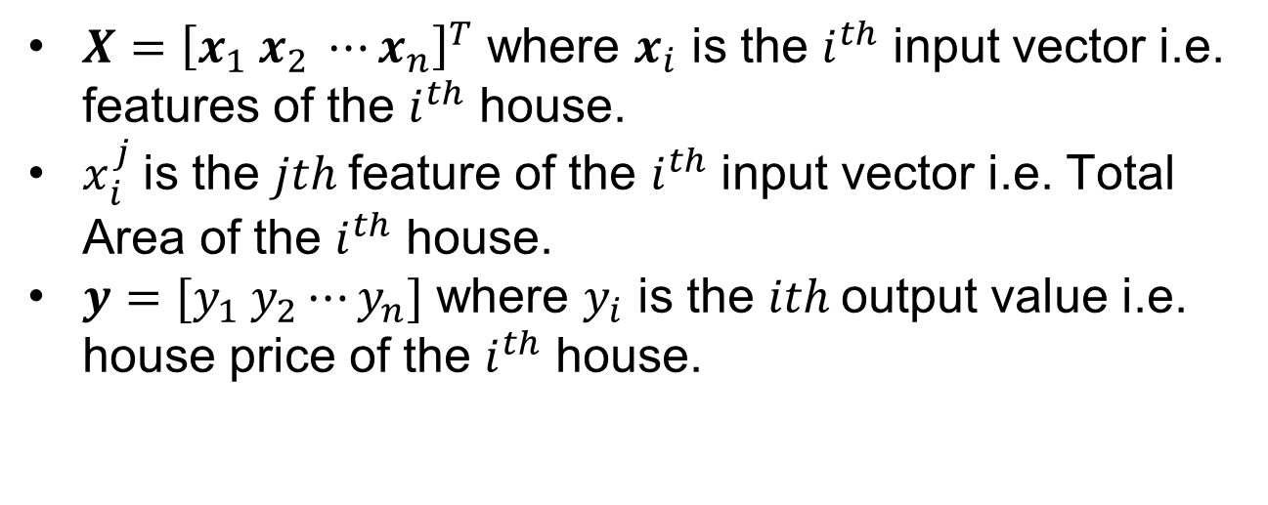
Training Data
$X={\left[x_{1} x_{2} ⋯x_{n}\right]}^{T}$ where $x_{i}$ is the $i^{th}$ input vector i.e. features of the $i^{th}$ house.
$x_{i}^{j}$is the $jth$feature of the $i^{th}$ input vector i.e. Total Area of the $i^{th}$ house.
$y=[y_{1} y_{2}⋯y_{n}]$ where $y_{i}$ is the $ith$output value i.e. house price of the $i^{th}$ house.

Slide 10
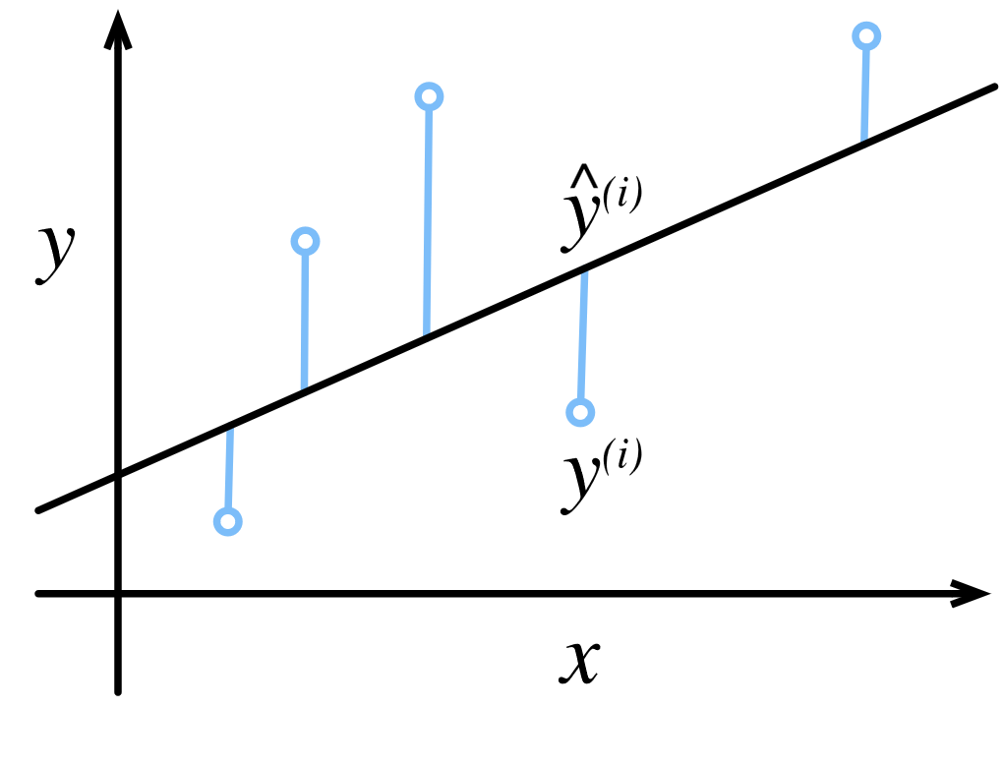
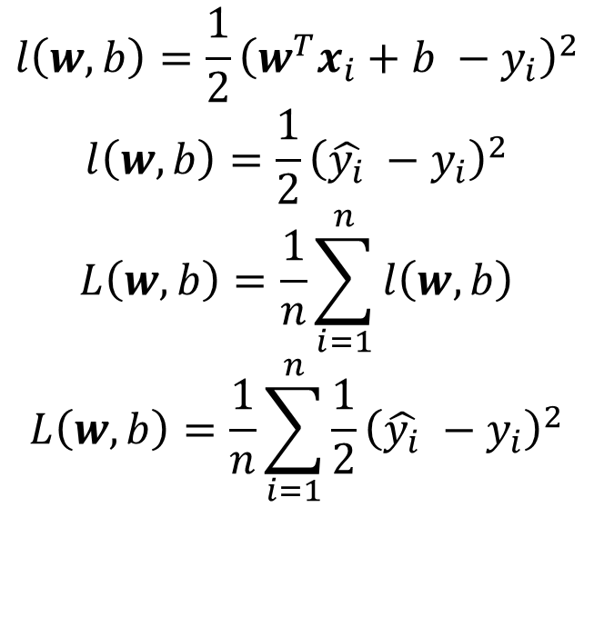
Training Loss of a Linear Regression Model
$$l\left(w,b\right)=\frac{1}{2}{\left(w^{T}x_{i}+b −y_{i}\right)}^{2}$$
$$l\left(w,b\right)=\frac{1}{2}{\left(\hat{y_{i}} −y_{i}\right)}^{2}$$
$$L\left(w,b\right)=\frac{1}{n}\sum_{i=1}^{n}{l\left(w,b\right)}$$
$$L\left(w,b\right)=\frac{1}{n}\sum_{i=1}^{n}{\frac{1}{2}{\left(\hat{y_{i}} −y_{i}\right)}^{2}}$$
Figure taken from d2l.ai

Slide 11
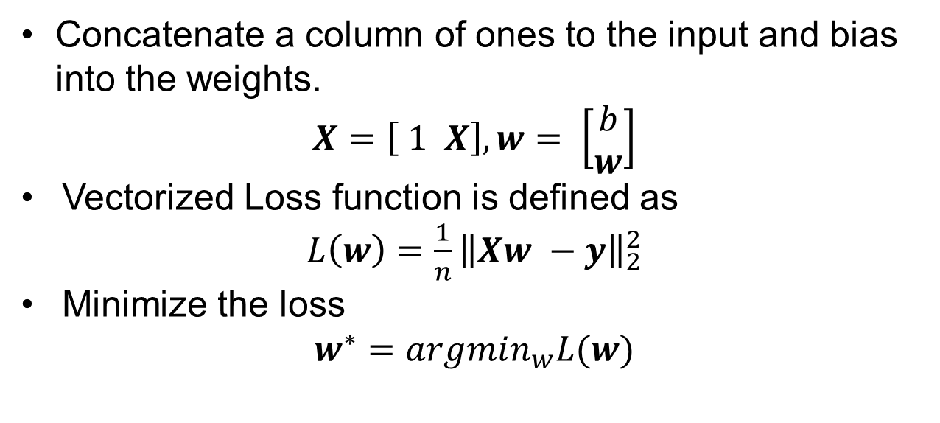
Vectorized Training Loss
Concatenate a column of ones to the input and bias into the weights.
$$X=\left[ 1 X\right], w= \left[\begin{matrix}b \\ w\end{matrix}\right]$$
Vectorized Loss function is defined as
$L\left(w\right)=\frac{1}{n}{\left\|Xw −y\right\|}_{2}^{2}$
Minimize the loss
$$w^{∗}=argmin_{w}L(w)$$

Slide 12
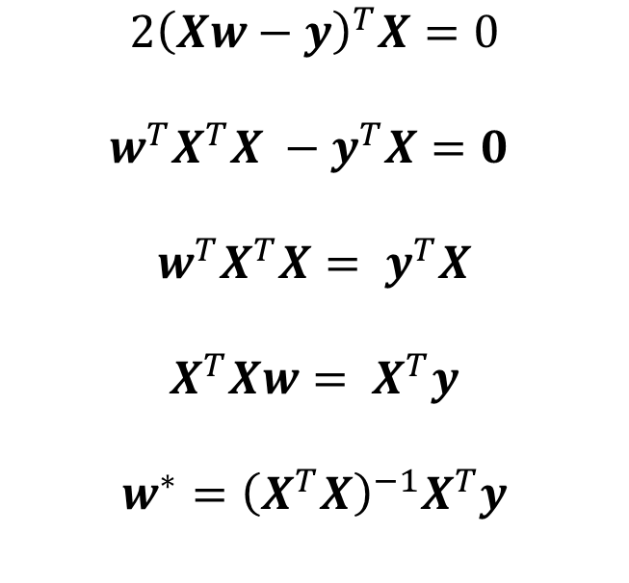
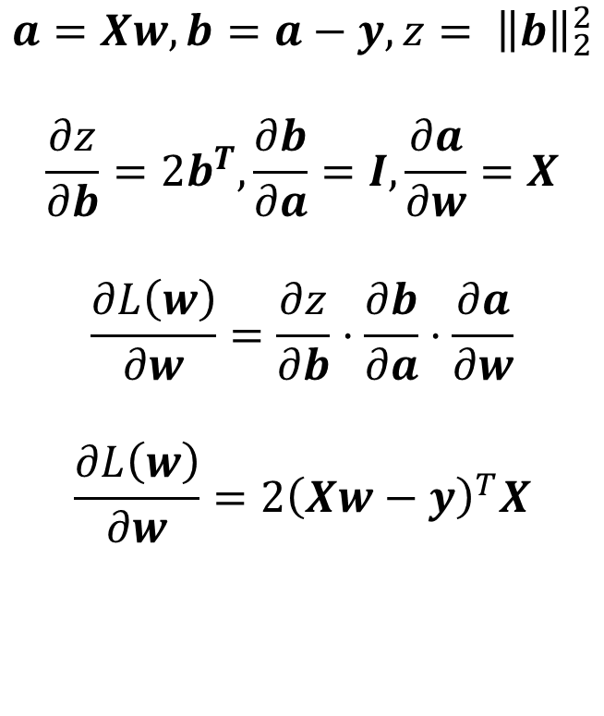
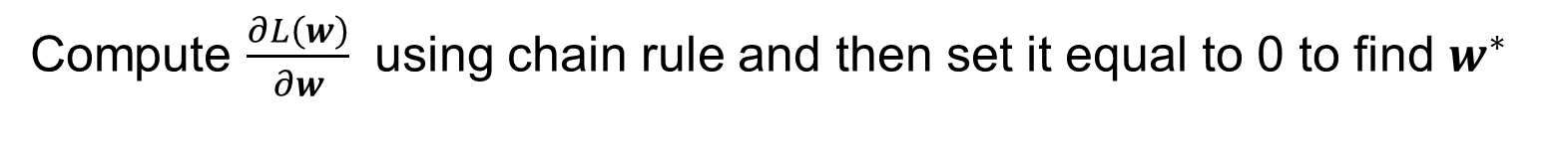
Closed Form Solution
Compute $\frac{∂L\left(w\right)}{∂w}$ using chain rule and then set it equal to 0 to find $w^{∗}$
$$a=Xw, b=a−y, z= {\left\|b\right\|}_{2}^{2}$$
$$\frac{∂z}{∂b}=2b^{T},\frac{∂b}{∂a}=I,\frac{∂a}{∂w}=X$$
$$\frac{∂L\left(w\right)}{∂w}=\frac{∂z}{∂b}⋅\frac{∂b}{∂a}⋅\frac{∂a}{∂w}$$
$$\frac{∂L\left(w\right)}{∂w}=2{\left(Xw−y\right)}^{T}X$$
$$2{\left(Xw−y\right)}^{T}X=0$$
$$w^{T}X^{T}X −y^{T}X=0$$
$$w^{T}X^{T}X= y^{T}X$$
$$X^{T}Xw= X^{T}y$$
$$w^{∗}={\left(X^{T}X\right)}^{−1}X^{T}y$$

Slide 13
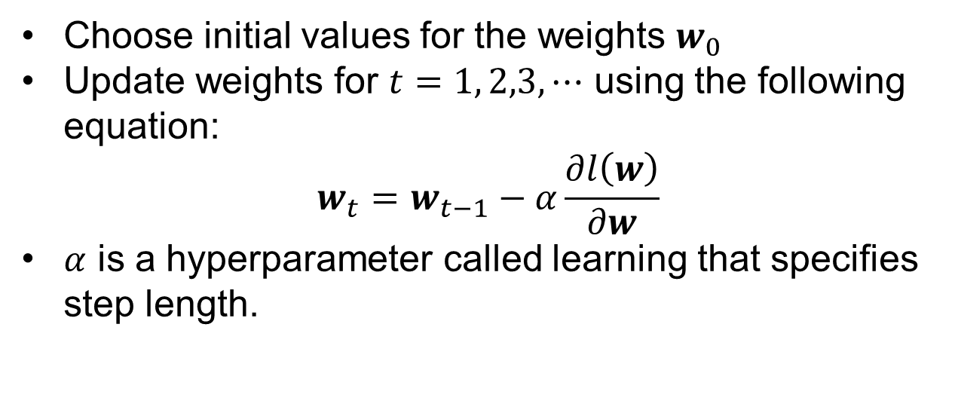
Gradient Descent Algorithm
Choose initial values for the weights $w_{0}$
Update weights for $t=1, 2,3, ⋯$ using the following equation:
$$w_{t}=w_{t−1}−α\frac{∂l\left(w\right)}{∂w}$$
$α$ is a hyperparameter called learning that specifies step length.

Slide 14
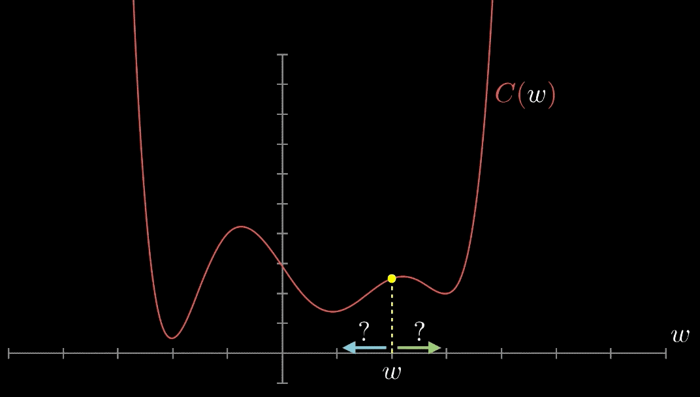
1D Gradient Descent Visualization
Figure taken from medium

Slide 15
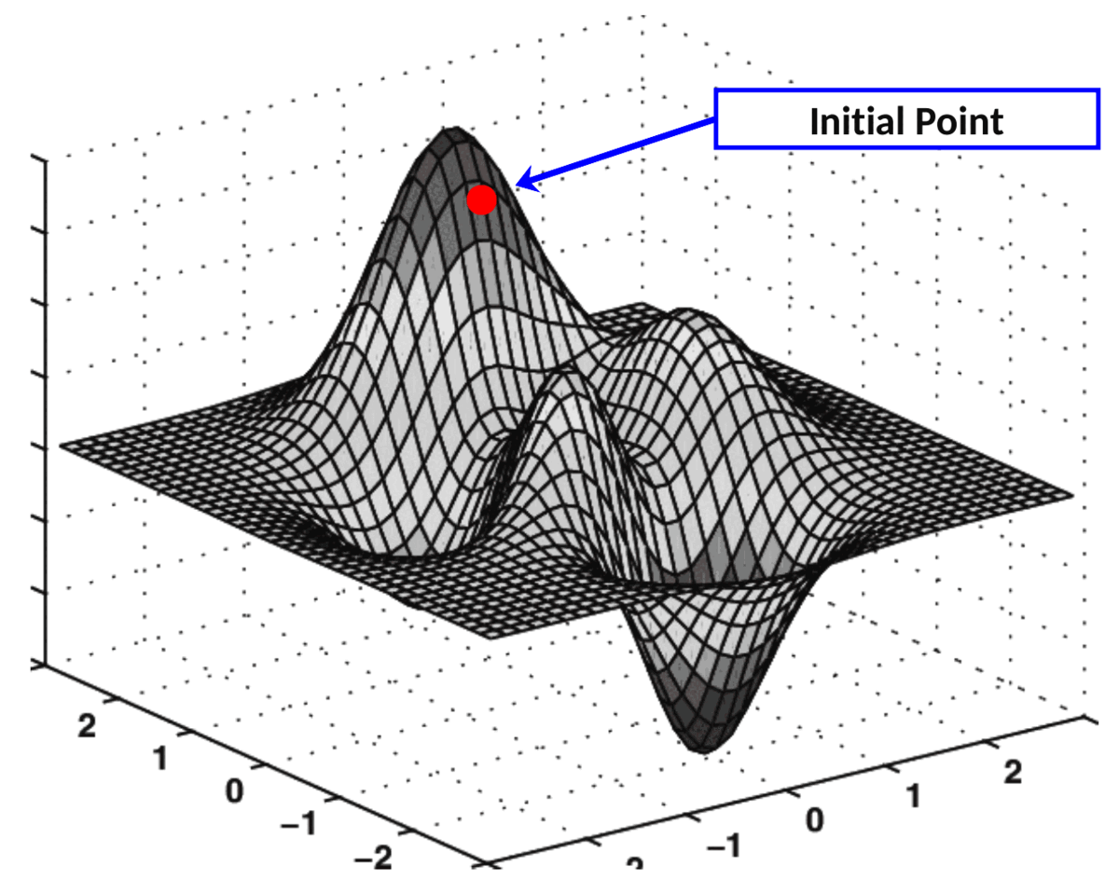
2D Gradient Descent Visualization
Figure taken from Towards AI

Slide 16
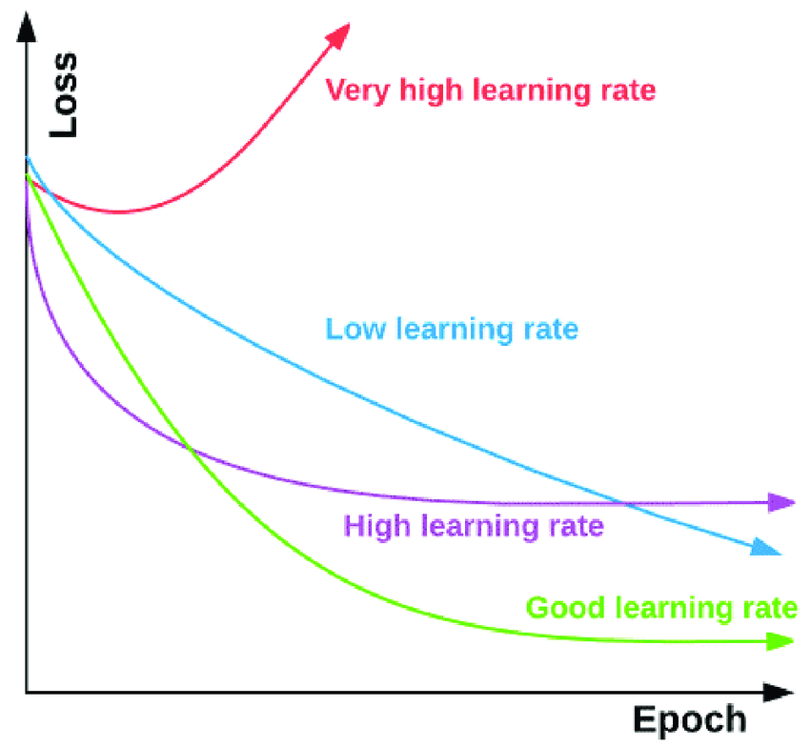
Learning Rate
When the learning rate is too small, the loss function converges is slowly.
When the learning is too big, the loss function may overshoot and even diverge.
Figure taken from ResearchGate

Slide 17
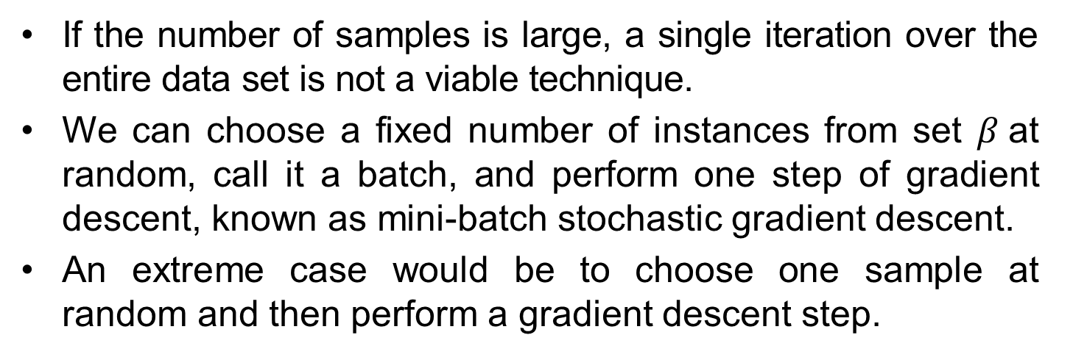
Mini-Batch Stochastic Gradient Descent
If the number of samples is large, a single iteration over the entire data set is not a viable technique.
We can choose a fixed number of instances from set $β$at random, call it a batch, and perform one step of gradient descent, known as mini-batch stochastic gradient descent.
An extreme case would be to choose one sample at random and then perform a gradient descent step.

Slide 18
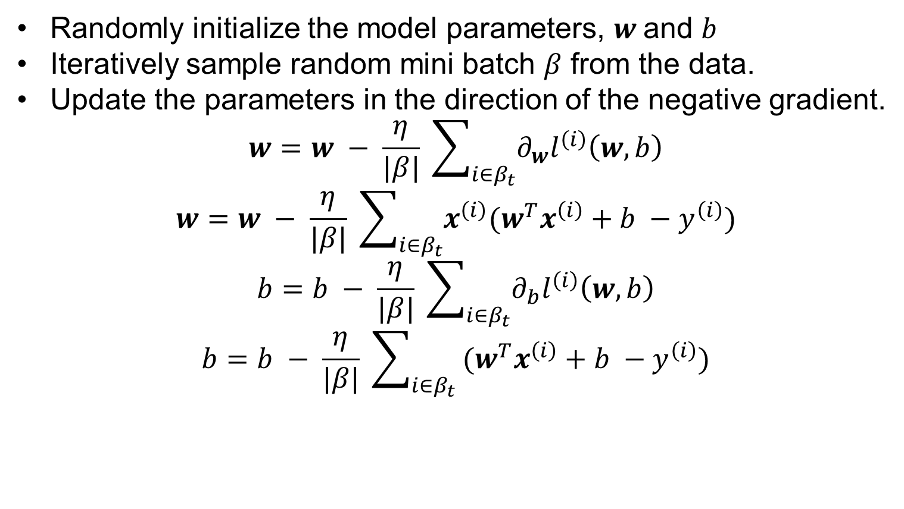
Mini Batch Stochastic Gradient Descent
Randomly initialize the model parameters, $w$and $b$
Iteratively sample random mini batch $β$ from the data.
Update the parameters in the direction of the negative gradient.
$$w=w − \frac{η}{|β|} \sum_{i∈β_{t}}{∂_{w}l^{\left(i\right)}\left(w,b\right)}$$
$$w=w − \frac{η}{|β|} \sum_{i∈β_{t}}{x^{\left(i\right)}(w^{T}x^{\left(i\right)}+b −y^{\left(i\right)})}$$
$$b=b − \frac{η}{|β|} \sum_{i∈β_{t}}{∂_{b}l^{\left(i\right)}\left(w,b\right)}$$
$$b=b − \frac{η}{|β|} \sum_{i∈β_{t}}{ (w^{T}x^{\left(i\right)}+b −y^{\left(i\right)})}$$

Slide 19
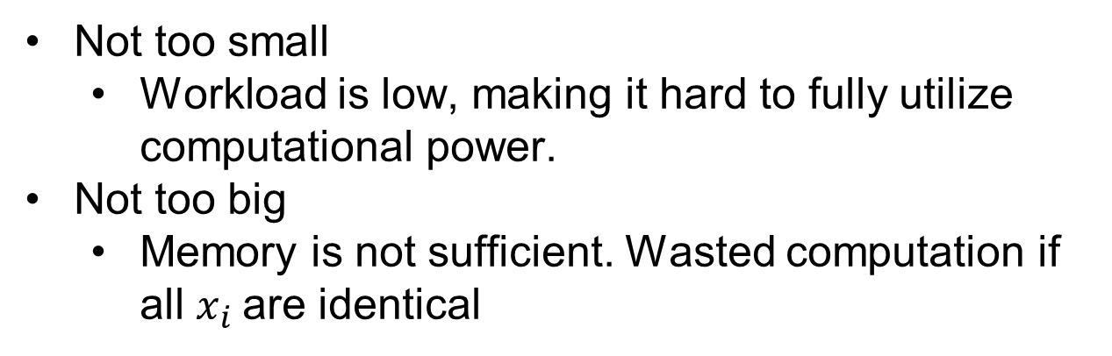
Batch Size
Not too small
Workload is low, making it hard to fully utilize computational power.
Not too big
Memory is not sufficient. Wasted computation if all $x_{i}$are identical

Slide 20
References
https://d2l.ai/chapter_linear-regression/index.html

